Slide 1

Sources of Financial Capital
TEAM MEMBERS
Akshat Sharma
Aman Chaturvedi
Shivam Jain
Gaurang Bansal

Slide 2
Introduction
A company converts ideas into products.
Sells it at a value higher than the production cost..
For this, a company requires capital.
“Financial Capital is enabler of enablers”
The question is, where do we get money(a.k.a Capital) for the company?
For this, we need to understand the types and sources of Capital.

Slide 3
3F’s Friends Family and Fools
Banks and financial institutions play a safe game.They just want money back with interest
Friends and family have always supported you and they believe you not the venture
Friends and family may generally work out as they are not demanding on your final projections as a professional investor
Fools they don’t recognize the risk in venture
They are generally not sophisticated investor rather they invest in foolish or whimsical manner

Slide 4
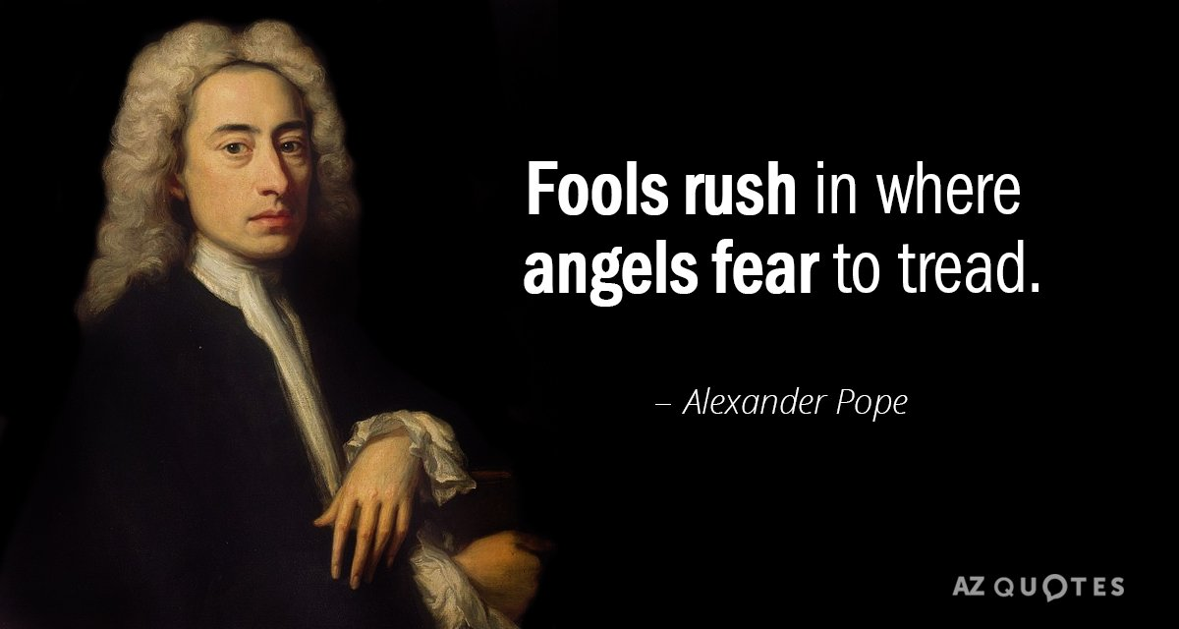
Friends Family and fools

Slide 5
Equity vs Debt
Debt Refers to the funds that are borrowed and must be paid at later date.
Provider of Loan capital do not have shares in company.
Some of Debt instruments are Loan Bonds Fixed Deposits.
Equity financing is the process of raising funds via selling shares in a company.
With equity finance comes the ownership interest of shareholders.

Slide 6
Sources of Equity Capital
For Startups/Private company
Angel Investors
Startup, pre-revenue
Venture Capital
Early stage, pre-profitable
Private Equity
Mid to later stage, profitable, cashflow
Notes:
In order to get Capital we need to know about its sources.

Slide 7

Angel Investors
'Form of angels'
Rich individuals
High risk ; high growth
Usually in exchange for convertible debt
Or ownership equity
Extreme Risk

Slide 8
Venture Capital Firms
Venture Capital - Money invested in early stage.
Place money from investors in strategically managed funds
Before investment
Perform a due diligence of the stability of company.
Equity shares <-> Capital
High Risk
Notes:
Investors get equity shares in the company in exchange of capital

Slide 9

Private Equity
Company ownership by a Specialized Investment Firm
Streamlining a current business in order to make it profitable.
Goal: Sell each business in few years -> Profit
Often target underperforming business
Use Management expertise
Moderate Risk

Slide 10
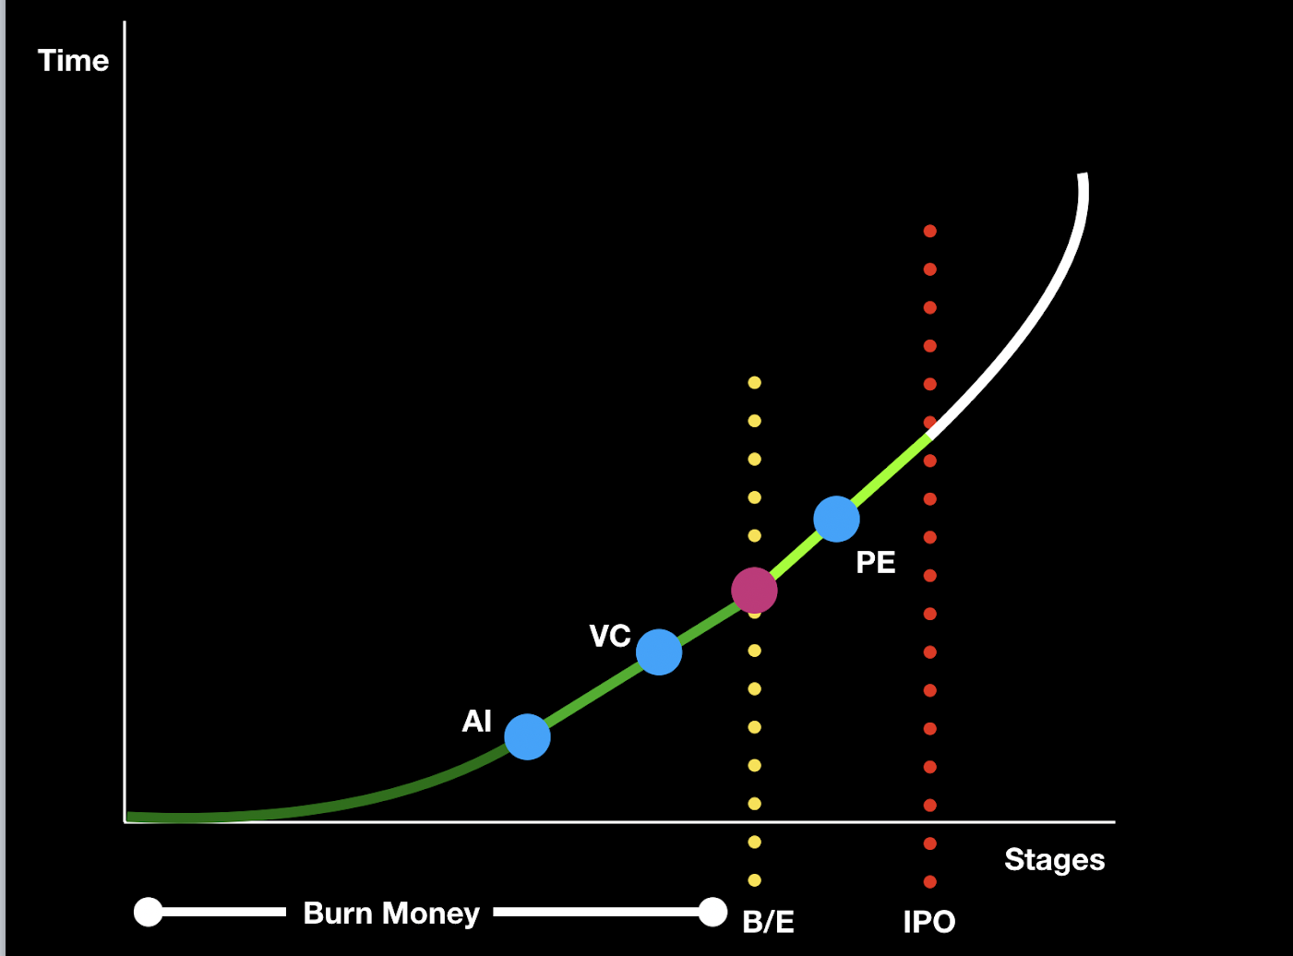
AI- How do they reduce risk?
Money Making for everyone.
Private Equity - To The IPO & exit.

Slide 11
What happens after a company has established itself?
It goes public (Initial public offering)
What is meant by going public?

Slide 12
Types of investors
Retail Investors- Individual investors investing small amounts
Institutional Investors-
Institutions investing huge amounts
Have a tremendous influence on stock market’s movements.
Eg. Insurance companies,Mutual Funds

Slide 13
References
https://www.investopedia.com/terms/r/retailinvestor.asp
https://www.quora.com/What-exactly-happens-when-a-company-goes-public
https://www.quora.com/What-does-fools-mean-in-family-friends-and-fools-in-seed-funding
https://inc42.com/resources/startup-funding-sources-friends-family-fools/

